Slide 1
Wave Retention Analysis
Cory McAboy

Slide 2
Agenda
Background
Retention at a Glance
SSO Retention
Donut Retention
ESO + SSO Retention
Wave Retention – Sales vs non-Sales

Slide 3
Agenda
Background
Retention at a Glance
SSO Retention
Donut Retention
ESO + SSO Retention
Wave Retention – Sales vs non-Sales

Slide 4
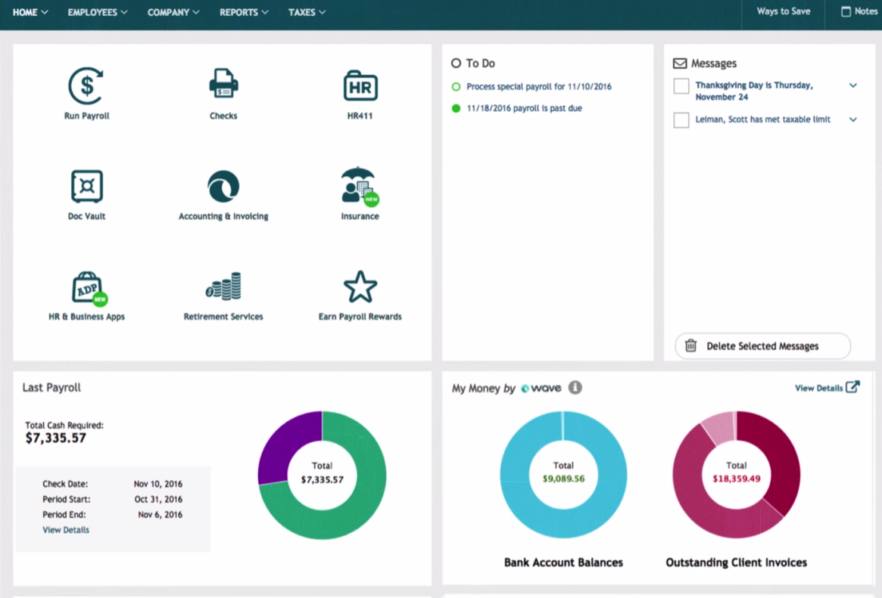
Wave is a great ancillary offering for ADP clients
Wave provides software products for Small Businesses:
  Accounting
  Invoicing
  Payments
ADP made an minor equity investment in the company
ADP customers have the option to integrate Wave features directly into ADP’s small business product, RUN.

Slide 5
Wave is free to ADP clients, but the client has to register with Wave directly
# of ADP SMB customers: 500k+
# of ADP SMB customers who have clicked the Wave icon: 16,039
# of ADP SMB customers who have used Wave: 3,163
Hypothesis: Customers who use Wave are more satisfied with the product than those who do not and thus, have more favorable retention rates

Slide 6
Retention for ‘new clients using Wave’ is compared to retention for ‘new clients not using Wave’
2 Populations used
  Group A: Wave Client
  Group B: Non Wave Client
Method
  For each month since September, retention is compared for clients starting in each month for Group A and Group B.
  The delta in retention is for each start month is then weighted based on number of clients in group A.
  The weighted deltas are summed together to get the estimated benefit in retention.
Possible Noise
  Small sample set of Wave users
  Small chance of survivorship bias for some of the studies.

Slide 7
Definition of Terms
ESO – Wave came with the Sales order
SSO – Client has obtained the activation token required to use Wave
Donut – Donut charts appear on the client’s homepage. This requires a confirmation step post SSO.

Slide 8
Agenda
Background
Retention at a Glance
SSO Retention
Donut Retention
ESO + SSO Retention
Wave Retention – Sales vs non-Sales

Slide 9
Retention Numbers of clients using Wave appear to be better than non-Wave users
 | Weighted Retention Delta | N | Survivorship Bias
SSO Clients | +4.10 | 1557 | Small
ESO Clients | +2.50 | 928 | Negligible
SSO Clients via ESO | +2.72 | 121 | Negligible
Donut Users | +2.16 | 847 | Small
Retention numbers are based on ~10 months worth of data. The data only include clients who started after Sep 27 2016.
*Survivorship Bias example – Client may have started in Jan, but did not sign up for wave until June. Other customers may have left in the interim.

Slide 10
Agenda
Background
Retention at a Glance
SSO Retention
Donut Retention
Wave Retention – Sales vs non-Sales

Slide 11
← Retention – Left Axis
The retention benefit of wave is high of those clients who have been with ADP 6 months and greater, but the
sample size of these clients are small.
Wave SSO N --Right Axis →
Notes:
Try to convert to R

Slide 12
Clients who have obtained the Wave SSO token have an improved retention of ~4.1 percentage points.
N = Client starts by month
Retention = % of clients who are still customers
Weight = % proportional to Wave-use N’s
Adjusted Difference = Delta * Weight

Slide 13
Agenda
Background
Retention at a Glance
SSO Retention
Donut Retention
ESO + SSO Retention
Wave Retention – Sales vs non-Sales

Slide 14
← Retention Percent – Left Axis
There is seems to be a retention benefit in the 6-12 month range
Wave Donut N’s → Right Axis

Slide 15
Clients who have obtained the Wave SSO token have an improved retention of ~2.16 percentage points.
N = Client starts by month
Retention = % of clients who are still customers
Weight = % proportional to Wave-use N’s
Adjusted Difference = Delta * Weight

Slide 16
Agenda
Background
Retention at a Glance
SSO Retention
Donut Retention
ESO + SSO Retention
Wave Retention – Sales vs non-Sales

Slide 18
Clients who have obtained the Wave SSO token and started with Wave via Sales Order (ESO) have an improved retention of ~2.7 percentage points.
N = Client starts by month
Retention = % of clients who are still customers
Weight = % proportional to Wave-use N’s
Adjusted Difference = Delta * Weight

Slide 19
Agenda
Background
Retention at a Glance
SSO Retention
Donut Retention
ESO + SSO Retention
Wave Retention – Sales vs non-Sales

Slide 20
← Retention % - Left Axis
# of New Clients (N) – Right Axis →

Slide 21
Retention appears to be better for Wave clients in Non-Sales channels

Slide 22
Appendix

Slide 23
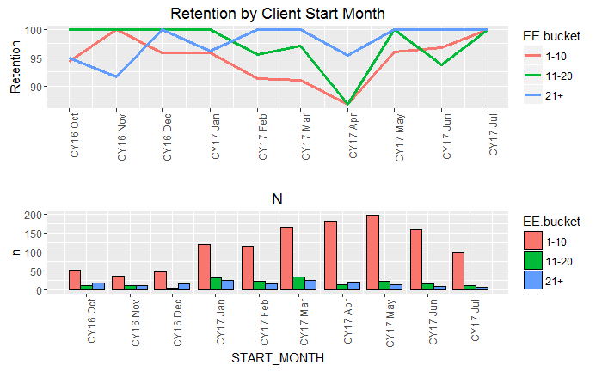

Slide 24
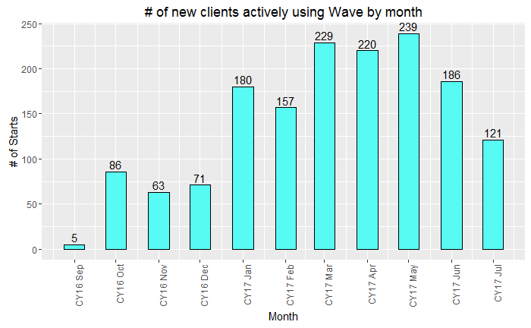
The number of new RUN clients signing up for Wave was low in CY16, but has picked up in CY17

Slide 25
Notes:
Try to do in R

Slide 26
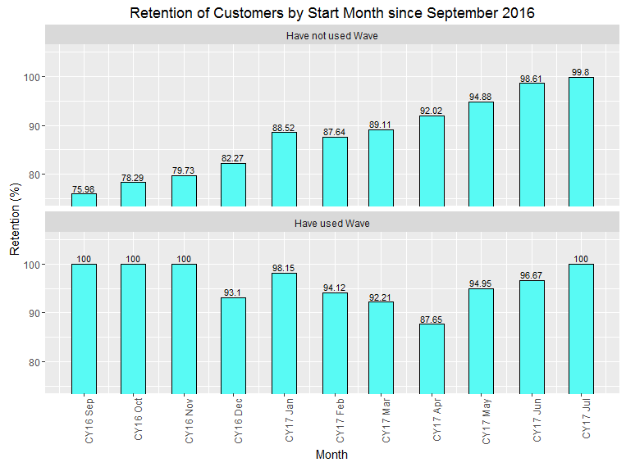
Retention by Start Date
Notes:
Add second axis for n

Slide 27
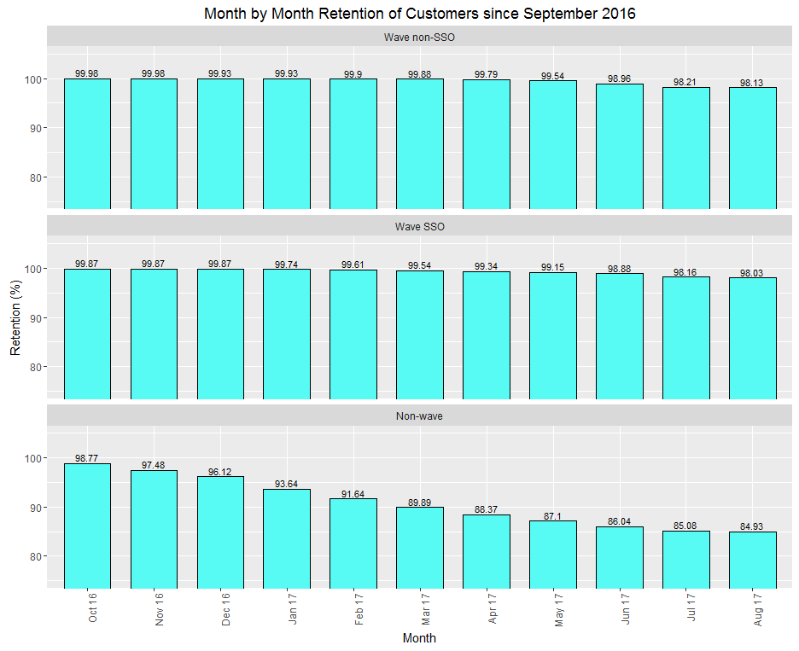
Retention Progression of pre-Sep2017 clients
The Wave data is subject to survivorship bias.

Slide 28
